Slide 1


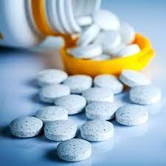
Patient's Condition Classification Using Drug Reviews
MENTOR: Mr. Adhvaith sir
Mr.Nataraj Sir
TEAM MEMBERS FROM (GROUP – 7)
Ms .UJWALA SANJAY PAWAR
Ms. TEJASWINI ASHOKRAO AHER
Mr. SHUBHAM BALASAHEB BHOSALE
Ms. AVANTI LAXMAN AVHAD
FIDA FEBIN K
Ms.MURSHIDA.AP

Slide 2
Patient's Condition Classification Using Drug Reviews
STEPS TOWARDS PROJECTSTEPS TOWARDS PROJECT
Objective Understanding
Project Architecture
Data importing
Exploratory Data Analysis
DATA VISUALIZATION
VISUALIZATION OF DRUG NAMES / RATINGS / CONDITION
Data pre-processing
Stopwords
Lemmatization
Creating Features and Target Variable
Bag of Words
Model Evaluation
Deployment
Problem Faced on this project

Slide 3
Objective Understanding
In this sample dataset which consists of 161297 drug name, condition reviews and ratings from different patients and our goal is to examine how patients are feeling using the drugs their positive and negative experiences so that we can recommend him a suitable drug. By analysing the reviews, we can understand the drug effectiveness and its side effects.
The dataset provides patient reviews on specific drugs along with related conditions and a 10 star patient rating reflecting overall patient satisfaction. So in this dataset, we can see many patients conditions but we will focus only on the below, classify the below conditions from the patients reviews
a) Depression
b) High Blood Pressure
c) Diabetes, Type 2

Slide 4
Project Architecture / Project Flow
Objective Understanding
Data importing
Data Pre-processing
Model Evaluation
Exploratory Data Analysis
Model Deployment

Slide 5
Data Importing
The dataset provides patient reviews on specific drugs along with related conditions and a 10 star patient rating reflecting overall patient satisfaction.
Attribute Information:
1.DrugName (categorical): name of drug 2. condition (categorical): name of condition 3. review (text): patient review
4. rating (numerical): 10 star patient rating 5. date (date): date of review entry 6. usefulCount (numerical): number of users who found review useful

Slide 6
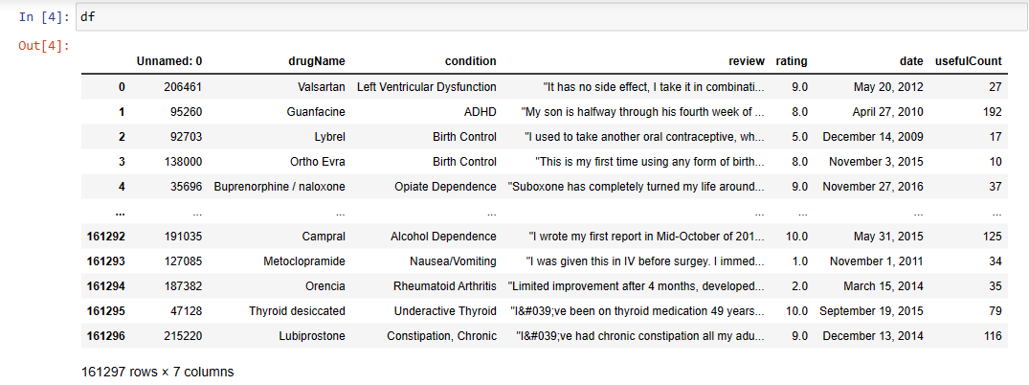
Data Collection & Details
Import Dataset
• 161297 Rows and 7 Columns
Attribute Information:
1. DrugName (categorical): name of drug
2. condition (categorical): name of condition
3. review (text): patient review
4. rating (numerical): 10 star patient rating •
5. date (date): date of review entry
6. usefulCount (numerical): number of users who found review useful

Slide 7
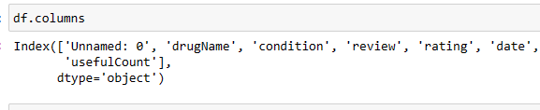
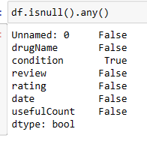
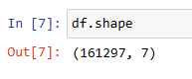
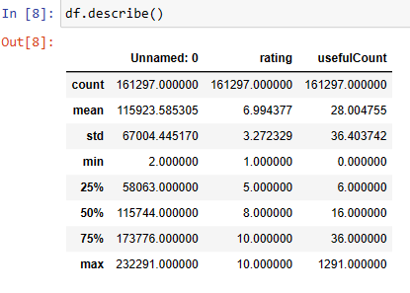
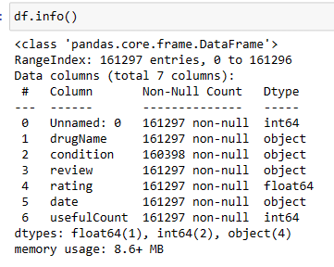
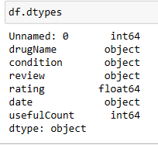
Details
Columns
Shapes
Is null is present
Describes
Infromation
Data type

Slide 8
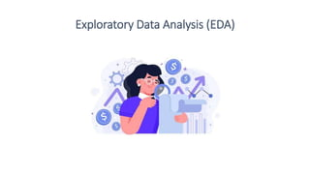

Slide 9
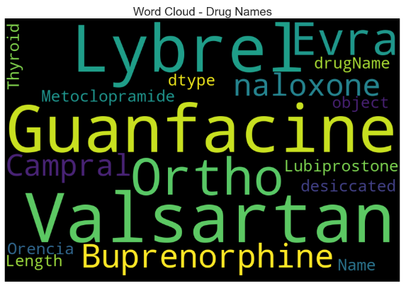
Exploratory Data Analysis DATA VISUALIZATION VISUALIZATION OF DRUG NAMES / RATINGS / CONDITIONS
let's see the words cloud for the reviews

Slide 10
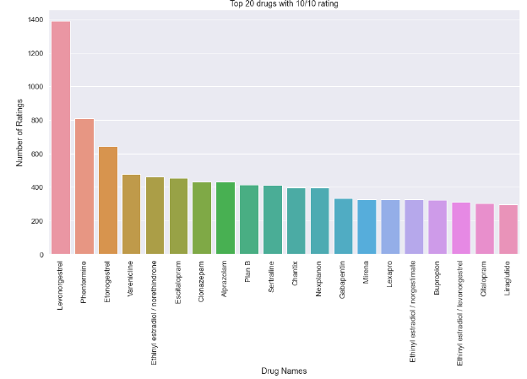
VISUALIZATION OF DRUG NAMES / RATINGS / CONDITIONS
This barplot shows the top 20 drugs with the 10/10 rating
The is a bar graph which shows the top 20 drugs given in the data set with a rating of 10/10. 'Levonorgestrel' is the drug with the highest number of 10/10 ratings

Slide 11
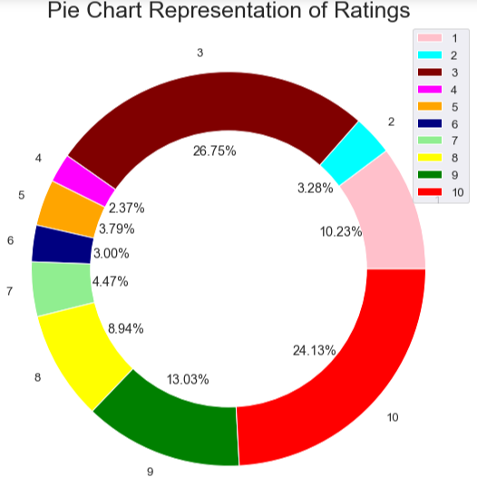
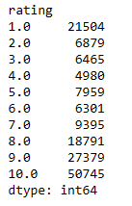
Exploratory Data Analysis
Distribution of rating by size
Making a donut chart to represent share of each ratings

Slide 12
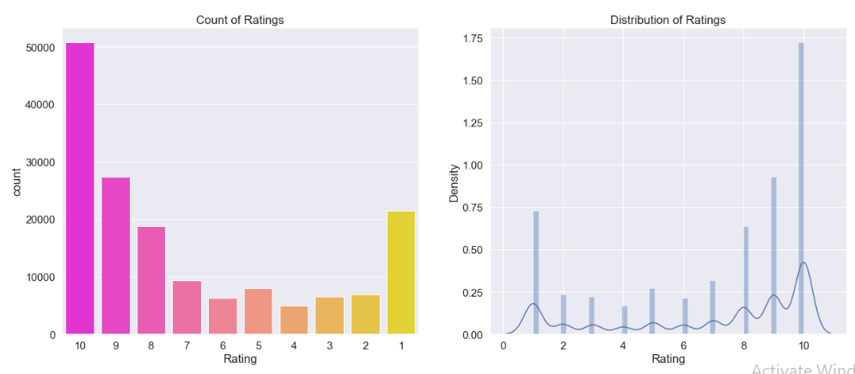
Exploratory Data Analysis
A countplot of the ratings so we can see the distribution of the ratings
The shows a distribution plot on the right hand side and a bar graph of the same on the left hand side. This shows the distribution of the ratings from 1 to 10 in the data set.

Slide 13
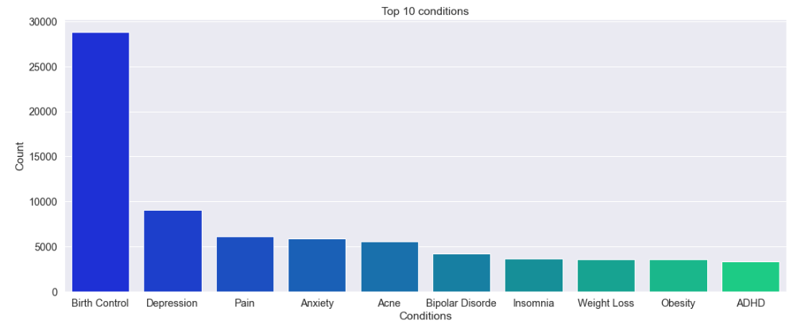
Exploratory Data Analysis
This barplot show the top 10 conditions the people are suffering.
The is a bar graph which exhibits the top 10 conditions the people are suffering from. In this data set 'Birth Control' is the most prominent condition by a very big margin followed by Depression and pain.

Slide 14
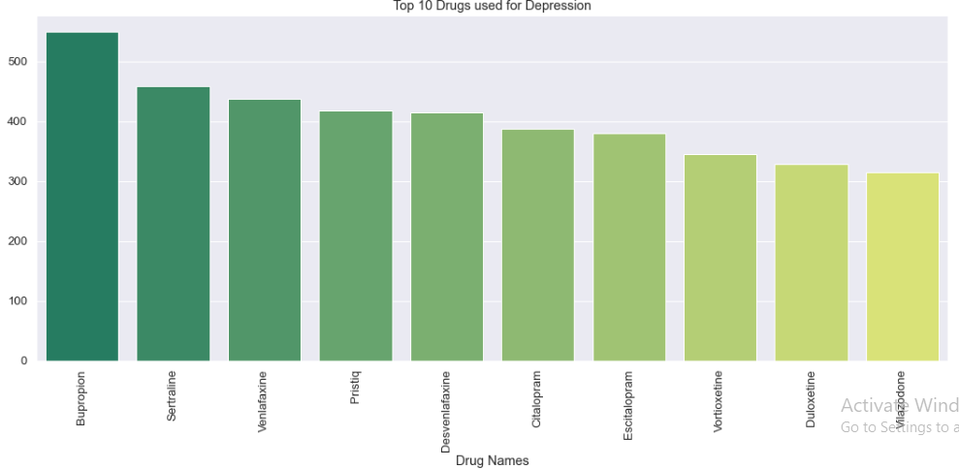
Exploratory Data Analysis
Top 10 drugs which are used for the top condition, that is Depression

Slide 15
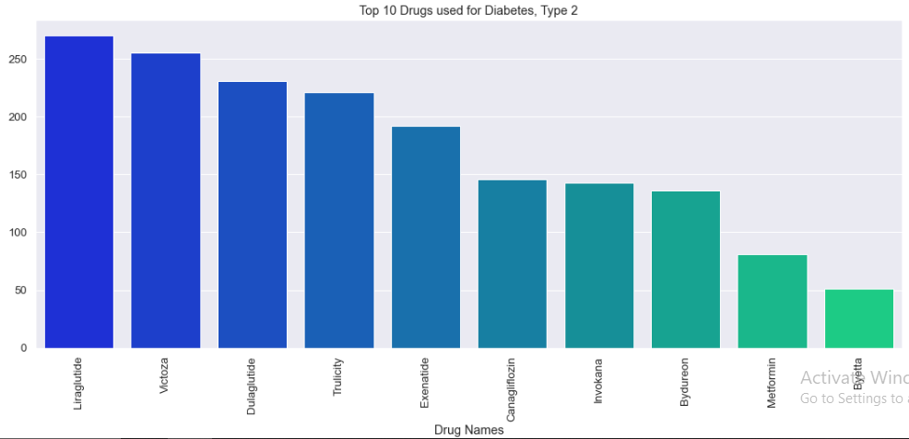
Exploratory Data Analysis
Top 10 drugs which are used for the top condition, that is Diabetes, Type 2

Slide 16
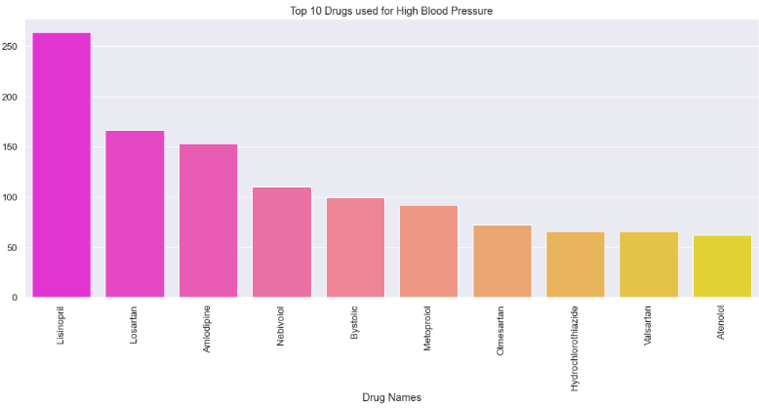
Exploratory Data Analysis
Top 10 drugs which are used for the top condition, that is High Blood Pressure:
This a bar graph which exhibits the top 10 drug names for the people suffering from High Blood Pressure. In this data set 'Lisinopril' is the most prominent drug by a very big margin.

Slide 17
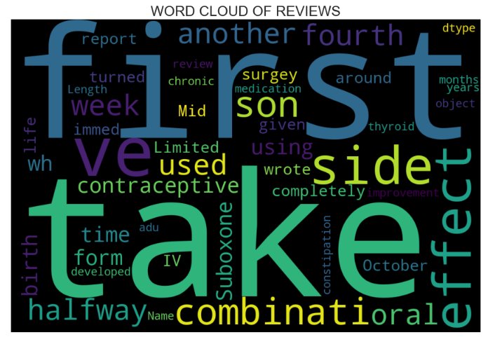
VISUALIZATION OF REVIEWS
Let's see the words cloud for the reviews

Slide 18
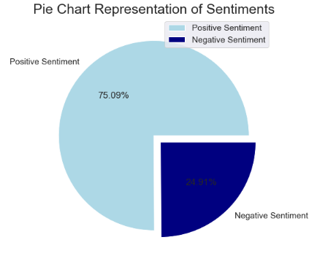
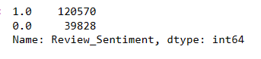
VISUALIZATION OF REVIEWS
pie chart to represent the sentiments of the patients
feature engineering
let's make a new column review sentiment

Slide 19
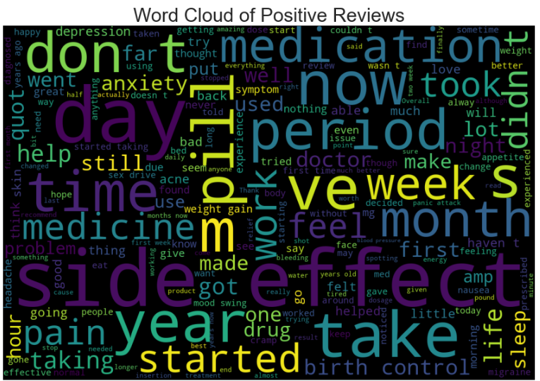
Word cloud For Positive Reviews

Slide 20
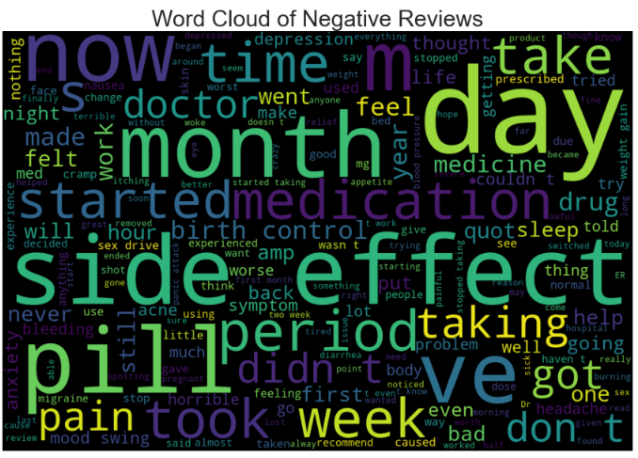
Word cloud For Negative Reviews

Slide 21
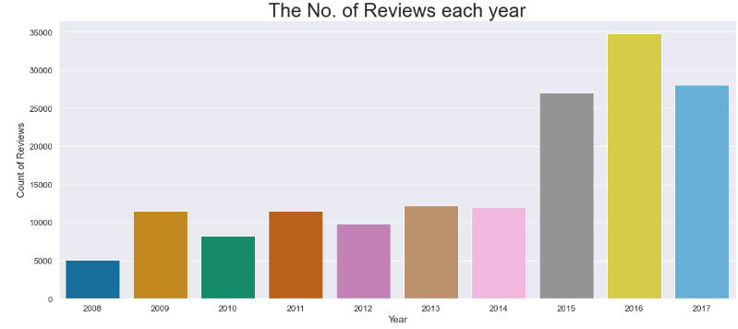
VISUALIZATION OF REVIEWS BASED ON DATETIME
Looking at the no. of reviews in each of the year
The is a Bar graph that shows the number of reviews in the data set per year. It can be inferred that most ratings are given in 2016 and 2008 has the least number of reviews

Slide 22
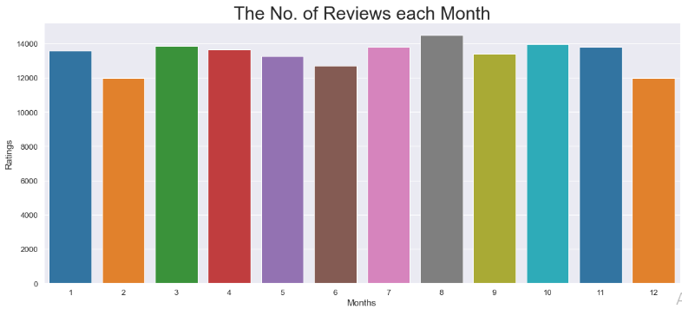
VISUALIZATION OF REVIEWS BASED ON DATETIME¶

Slide 23
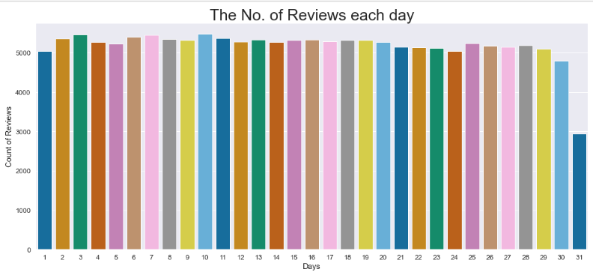
Looking at the no. of reviews in each of the day

Slide 24
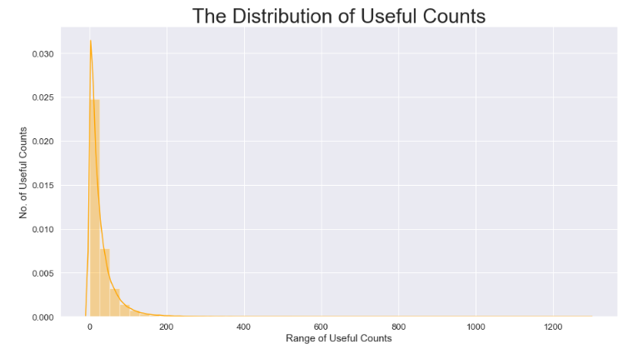
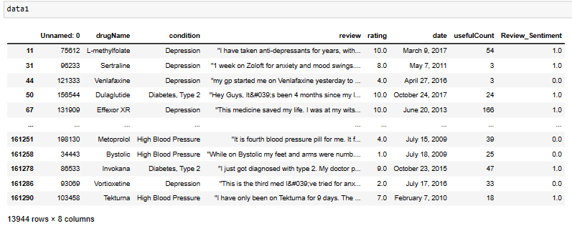
VISUALIZATION OF USEFUL COUNT

Slide 25
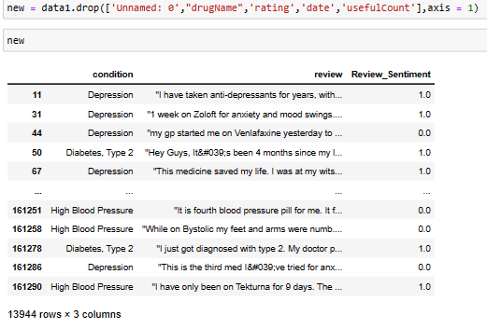
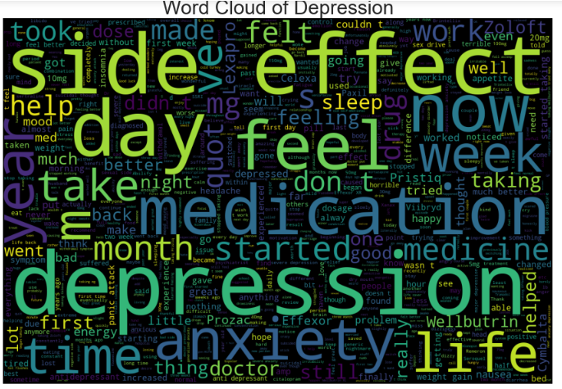
VISUALIZATION OF USEFUL COUNT
Making Words cloud for the condition of Depession

Slide 26
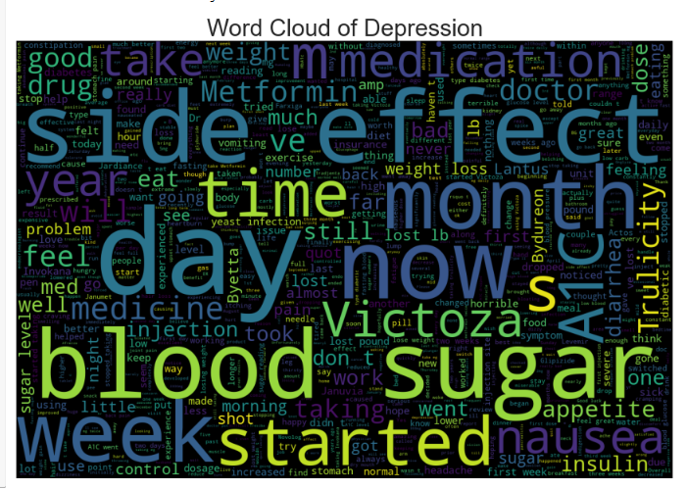
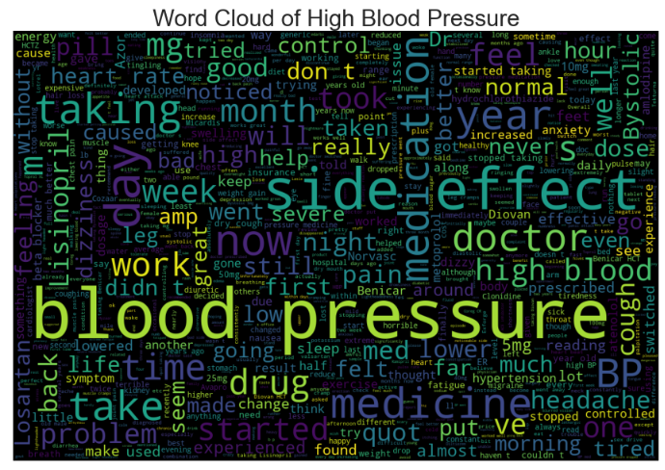
Making Words cloud for the condition of Diabetes, Type 2,Blood Pressure

Slide 27
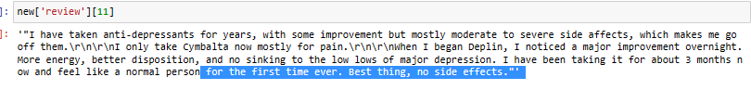
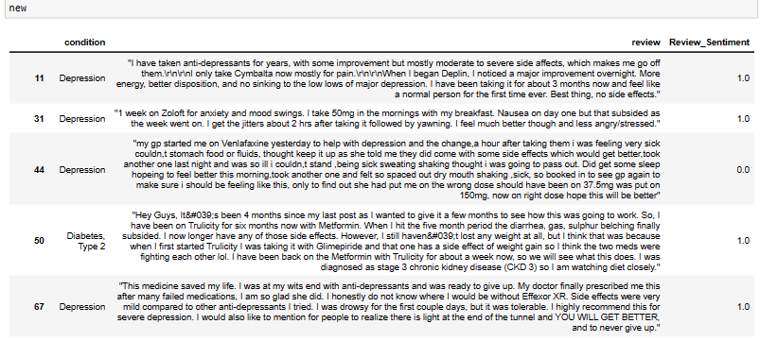
DATA PREPROCESSING

Slide 28
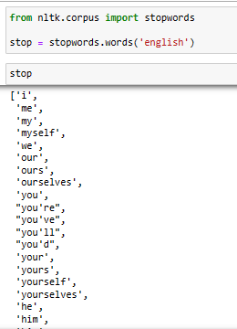
STOPWORDS

Slide 29
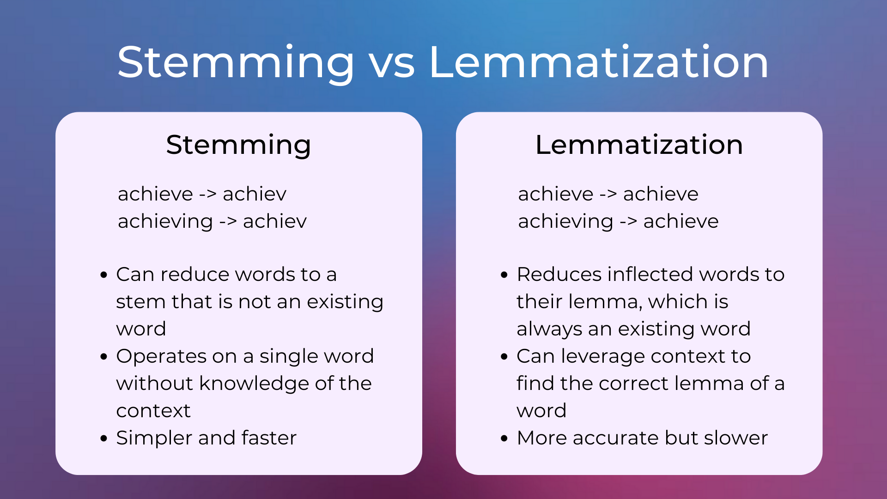
Lemmatization

Slide 30
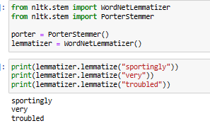
Lemmatization

Slide 31
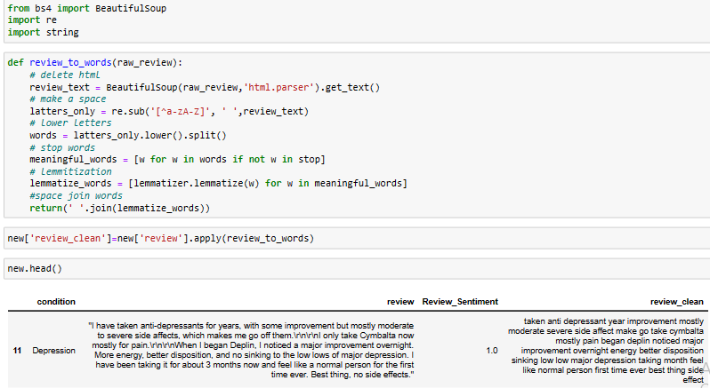
Lemmatization

Slide 32
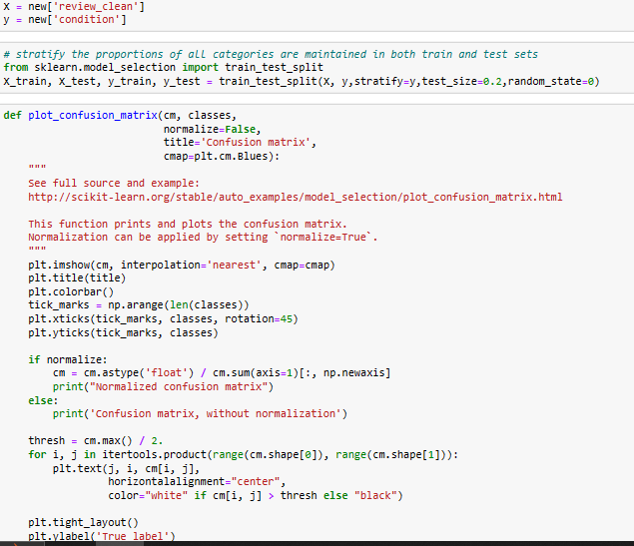
Creating Features and Target Variable

Slide 33
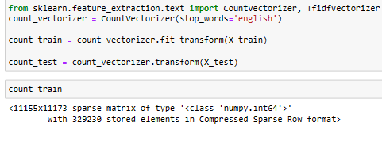
Bag of Words

Slide 34
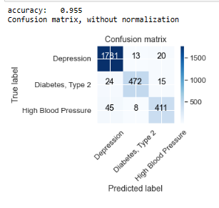
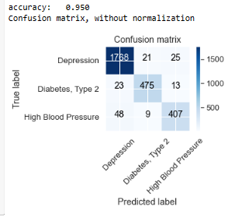
Model Evaluation Machine Learning Models
Naive Bayes¶
Passive Aggressive Classifier

Slide 35
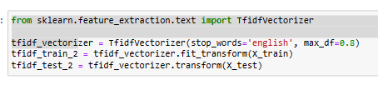
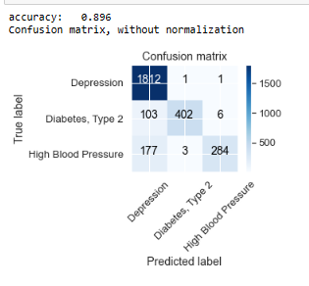
Machine Learning Models
TFIDF
Naive Bayes¶

Slide 36
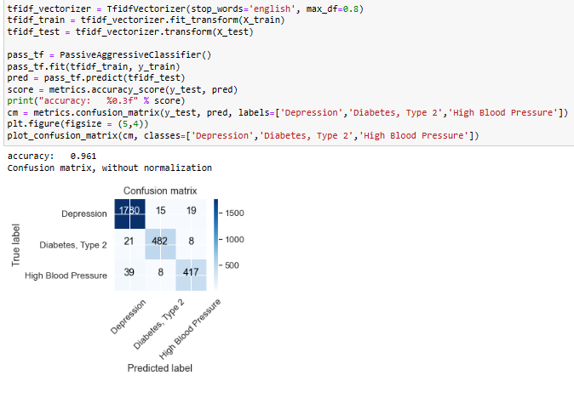
Machine Learning Models¶
TFIDF

Slide 37
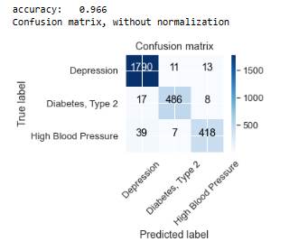
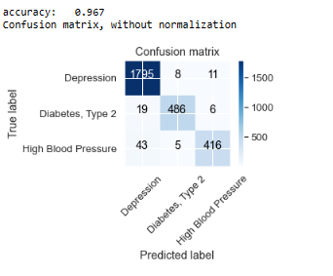
Machine Learning Models
TFIDF: Bigrams
TFIDF : Trigrams¶

Slide 38
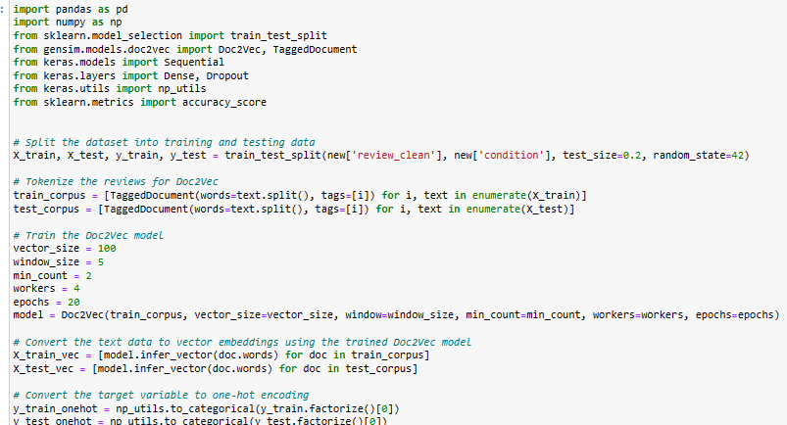
Doc2Vec embedding model

Slide 39
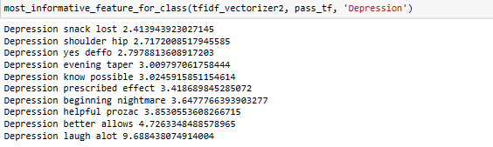
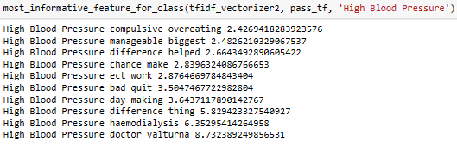
Most important Features

Slide 40


Most important Features
Sample Predictions

Slide 41

Function for Extracting Top drugs

Slide 42

Function for Extracting Top drugs

Slide 43

Function for Extracting Top drugs

Slide 44

Deployment using streamlit

Slide 45

Deployment using streamlit

Slide 46

Deployment using streamlit

Slide 47
Thank you..

